Slide 1

Team Food Waste:
Our Needfinding Experience
Grace Wu, Lewin Cary, Devangi Vivrekar
October 7, 2016
CS 147: Human-Computer Interaction Design

Slide 2
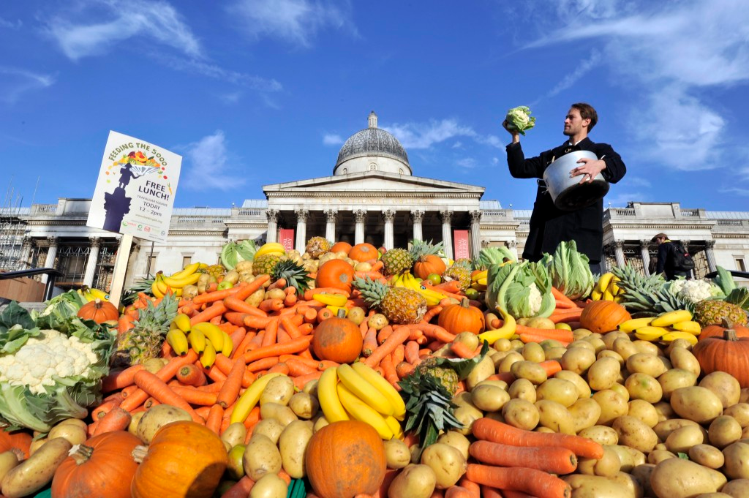
Outline
Introduction to Us
Our Focus Area
Needfinding Methodology
Interview Results
Initial Analysis

Slide 3
Outline
Introduction to Us
Our Focus Area
Needfinding Methodology
Interview Results
Initial Analysis

Slide 4



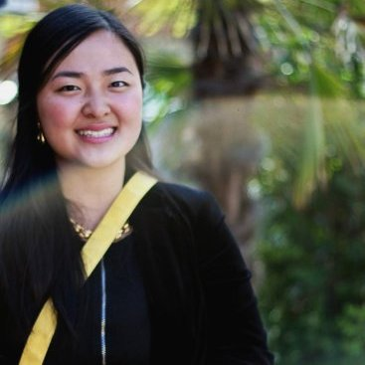
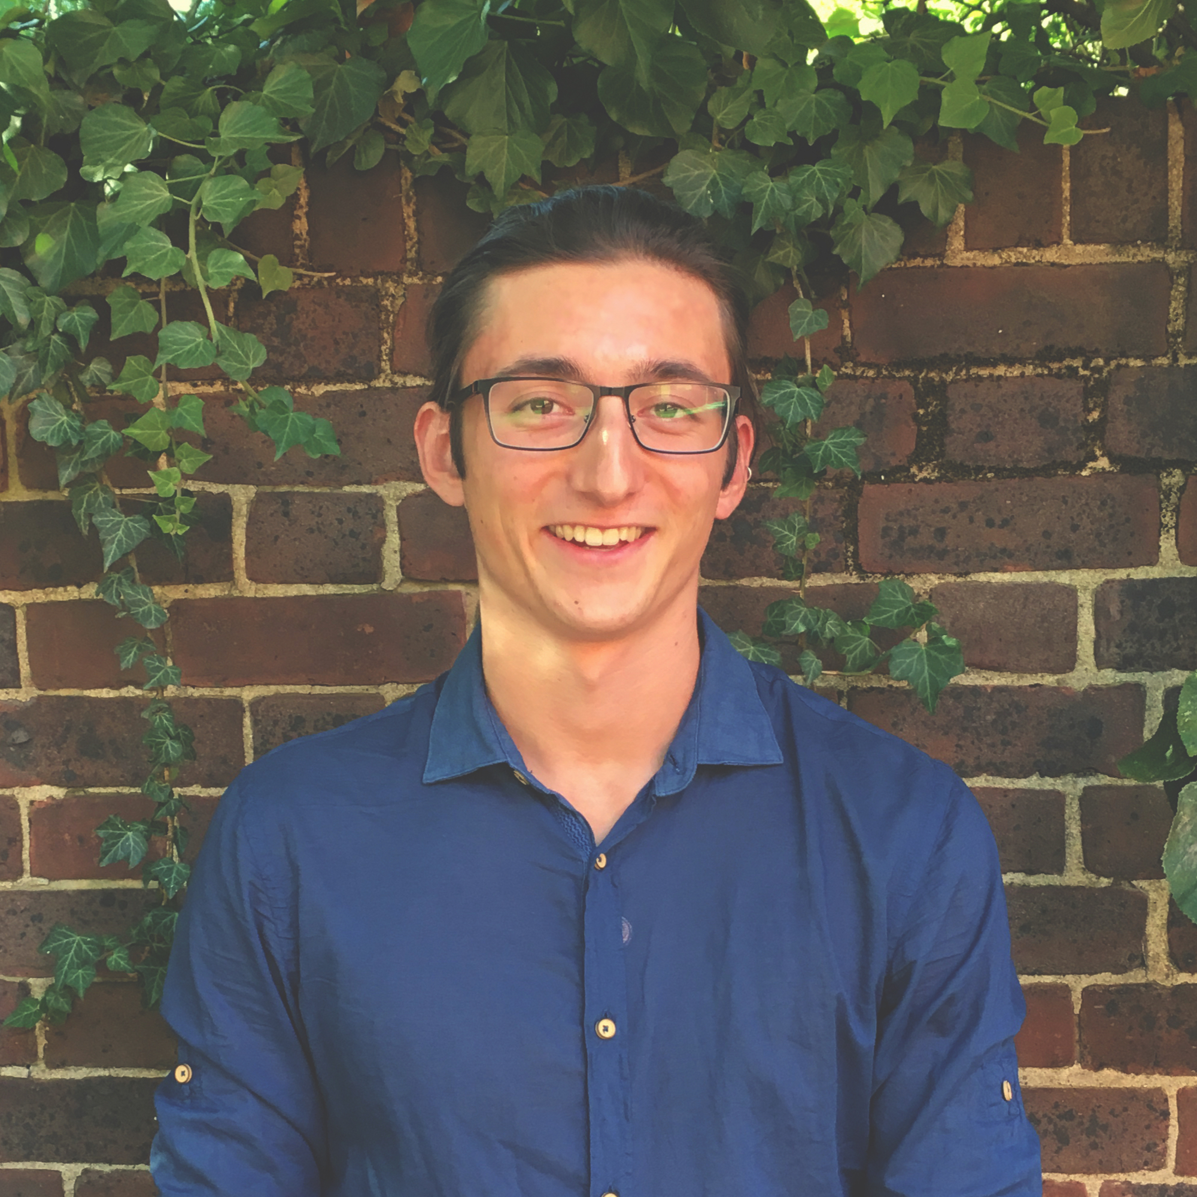
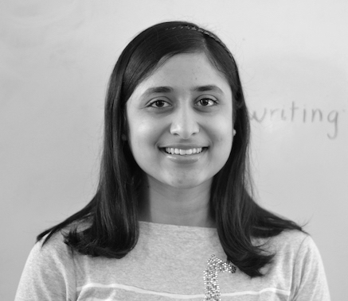
Introduction to Us

Slide 5
Outline
Introduction to Us
Our Focus Area
Needfinding Methodology
Interview Results
Initial Analysis

Slide 6
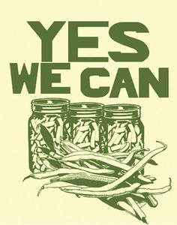

Personal Goals
Significant social good component
But “don’t just throw software at the problem”
Cohesive end-to-end experience
UX but also real-world component
POC in intended context
Learn basic mobile app development

Slide 7
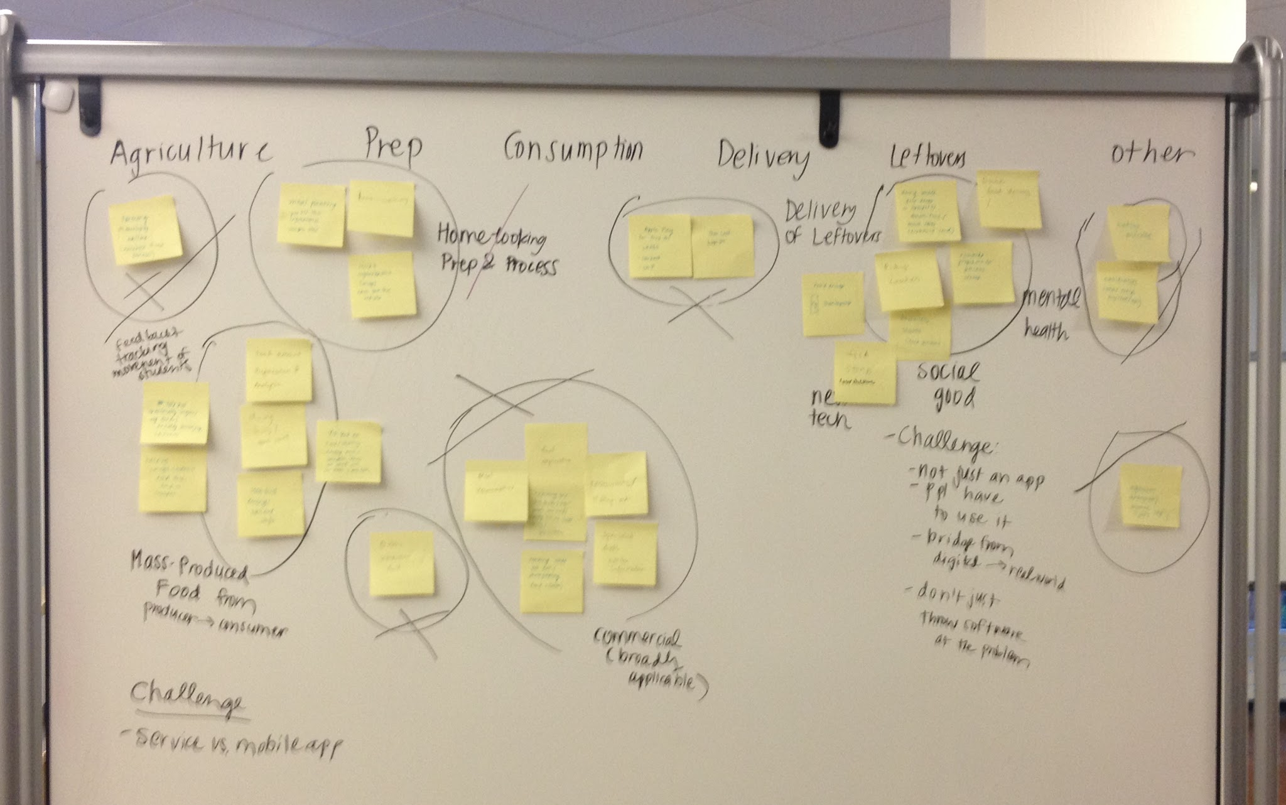
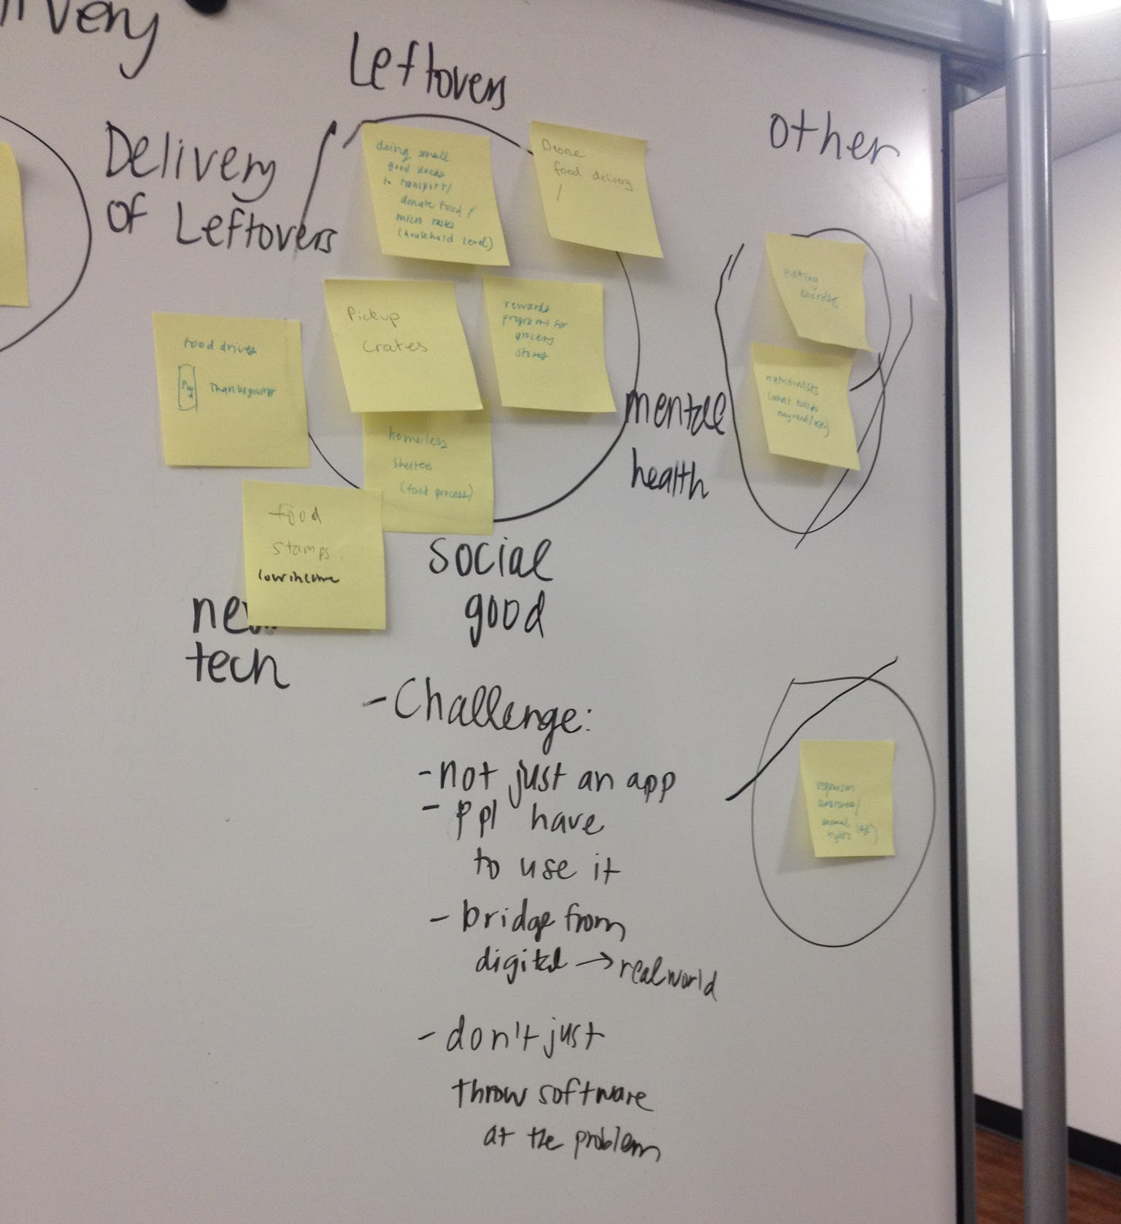
Narrowing a Focus Area

Slide 8
Use of tech in food drives
Food stamps
Pickup crates
Food waste
Food banks
Micro tasks: leftover donations on household level
Composting
Homeless shelters
Grocery store rewards programs for donations
Drone food pickup and delivery
Waste from small businesses

Slide 9
DElivery of leftovers and food waste to low-income populations for social good.

Slide 10
Outline
Introduction to Us
Our Focus Area
Needfinding Methodology
Interview Results
Initial Analysis

Slide 11
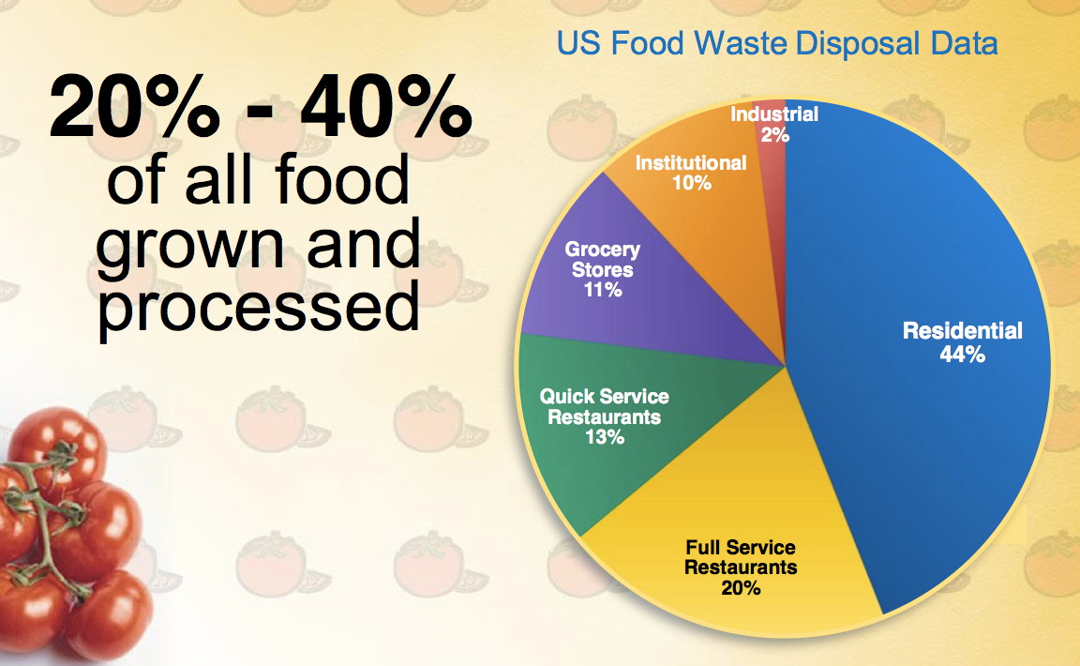
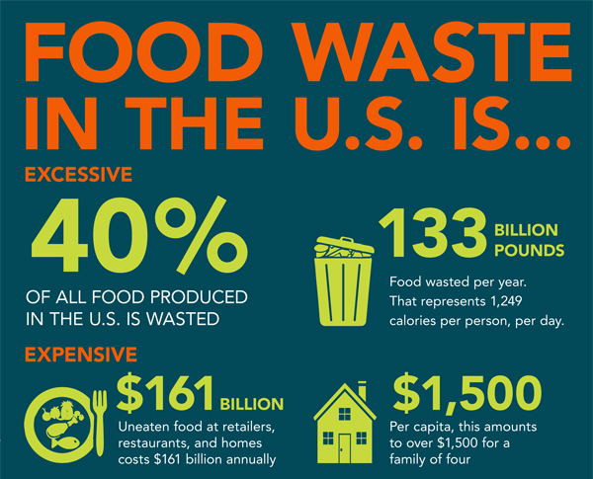
Understanding the Need Space

Slide 12
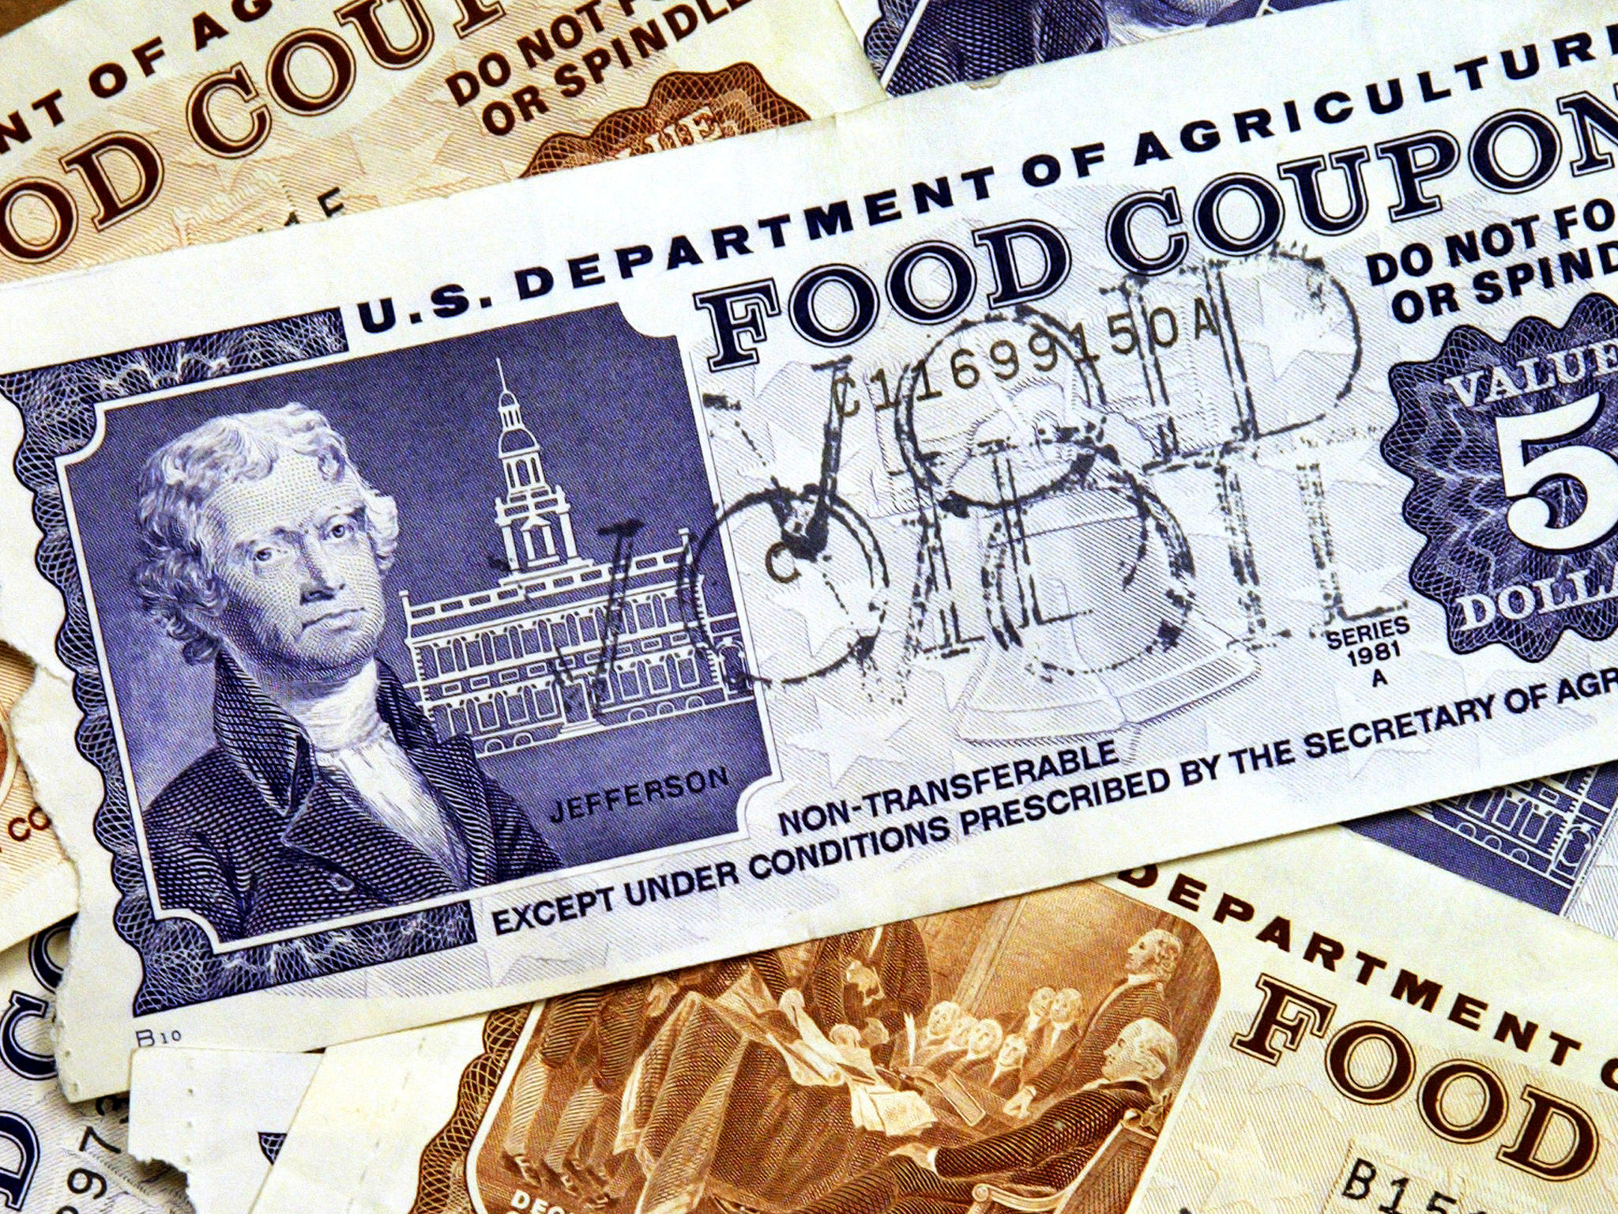





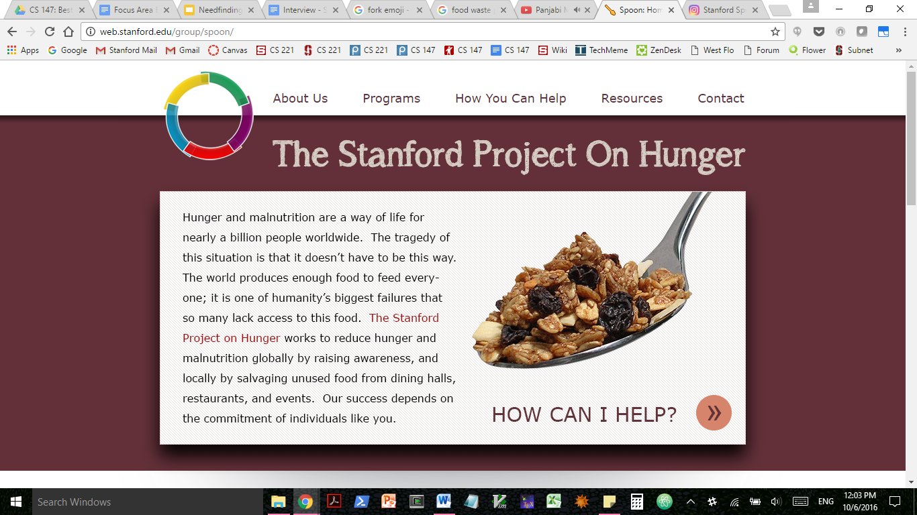




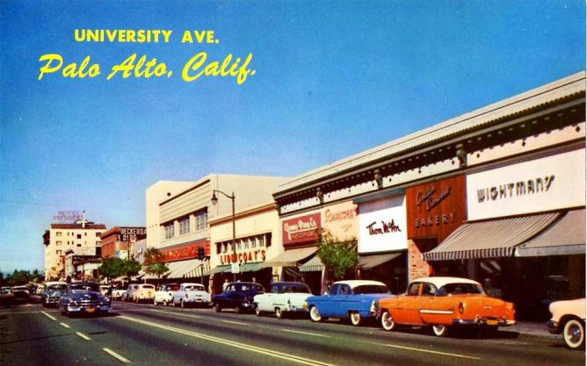
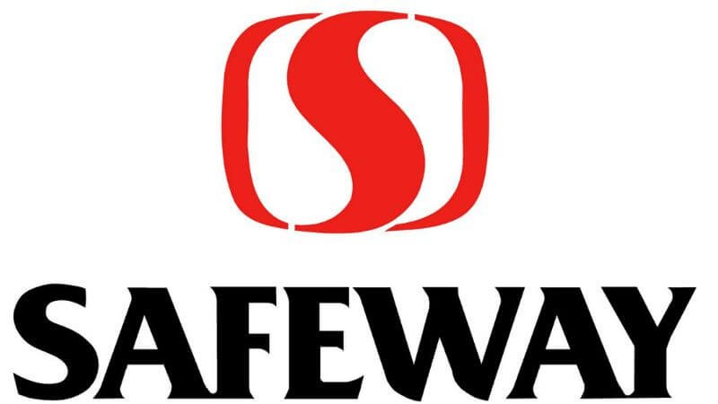
Understanding the Need Space

Slide 13
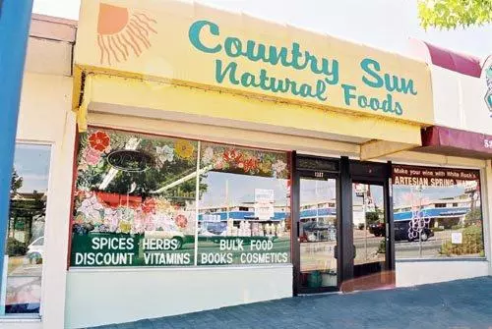
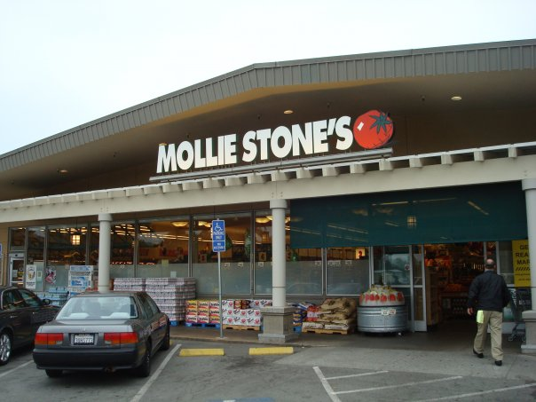
Choosing Interviews

Slide 14
Outline
Introduction to Us
Our Focus Area
Needfinding Methodology
Interview Results
Initial Analysis

Slide 15
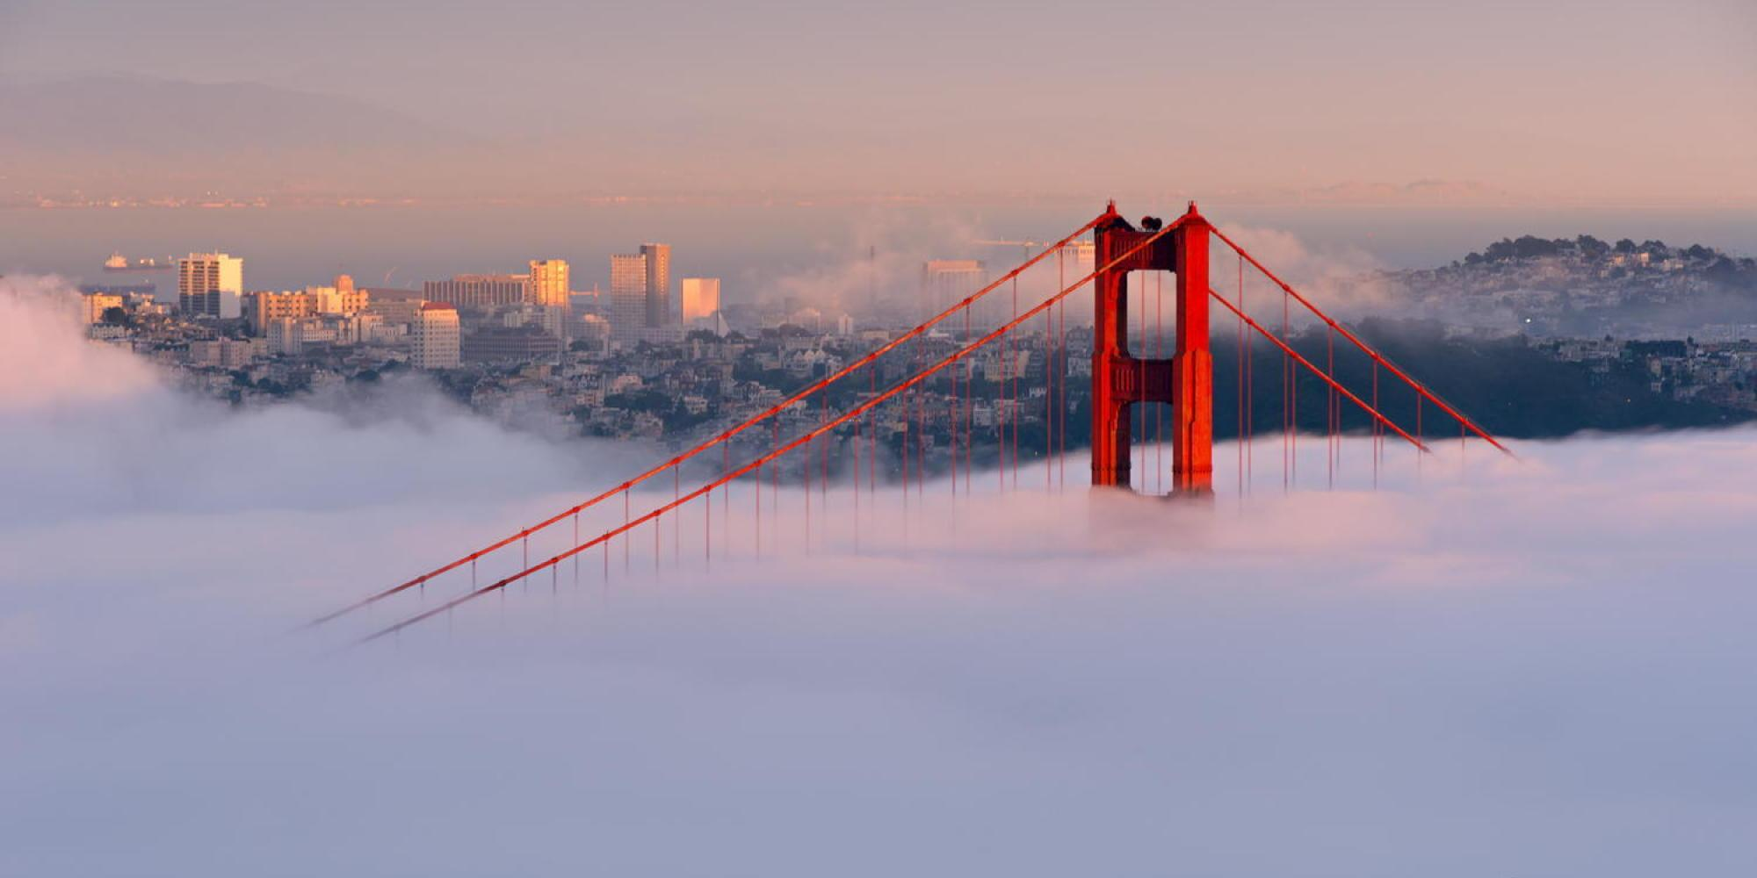
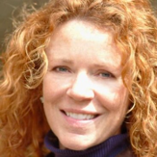
Reasons for choosing:
Established organisation in the Bay Area that collects and distributes leftovers from businesses and events
Utilises mobile application to find donations
Questions asked:
How do you find donors?
How much food is wasted vs saved in SF?
Why is there so much wasted food?
Where does the majority of waste come from?
Nancy Hahn

Slide 16

SAY
THINK
Nancy:
That tech companies prepare way too much food
There are many more people that still go hungry that we’re unaware of
How can we overcome the legal issues of this problem?
How can we make food lines a more comfortable environment?
Nancy:
“This is just a guess but we probably get around 50-60% of all businesses wasted food”
“Don’t know how much wasted food there is per day”
“People often aren’t sure what they’re allowed to throw away”
“Why are we buying food for 500 when only 200 are eating?”
“Often catering companies make you order a week in advance, so companies have to over order on purpose”
DO
Nancy:
Even though wasted food is good for her business, cringes at the idea of too much prepared food
Grateful for people that volunteer their time
Irritated by inefficiencies in her business, can’t say anything because they are volunteers
Exasperated by the American culture of over preparing/consuming too much
Warmed by the feeling of helping
·
FEEL
Nancy:
Nancy kept getting distracted during the phone call, was speaking with people in the background
Had to cancel the phone call in the middle to answer another call
Laughing about volunteer inefficiencies
Serious tone when talking about the extent of people in hunger

Slide 17
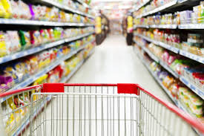
Grocery Stores
Can you walk me through how you deal with food waste?
Who do you donate to and how do they distribute the food?
Why do you throw away food instead of donating it?
How long do you keep things on the shelf for produce?
What are the problems you run into with donating food?

Slide 18
SAY
THINK
Andy:
-Donating is a burden
- Don’t have the labor to sort through food or coolers to store food
Trader Joe’s:
-Donating is the right thing to do for the local community
Andy:
- ”It (donating) becomes a policing issue.”
- “We don’t know if others will get sick from eating the produce”
Trader Joe’s:
- Give unsellable produce to local organizations, who handle distribution
DO
Andy:
- Mistrust
- Guilty because of food waste but did not have good experiences with other solutions.
Trader Joe’s:
- Doing good for the community
FEEL
Andy:
-Compost all food waste away
Trader Joe’s:
- All Trader Joe’s locations sort their produce each morning and donate to local organizations

Slide 19
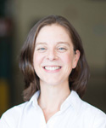
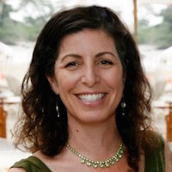
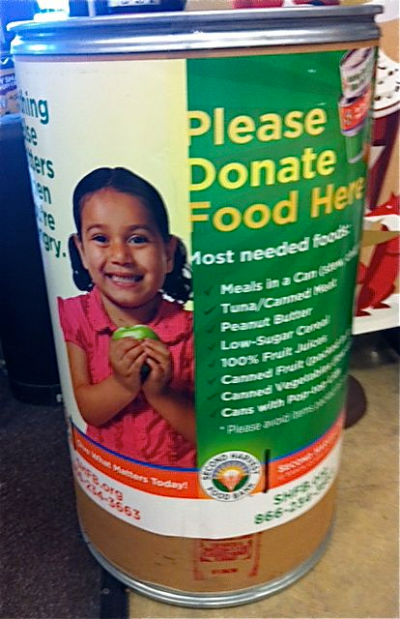
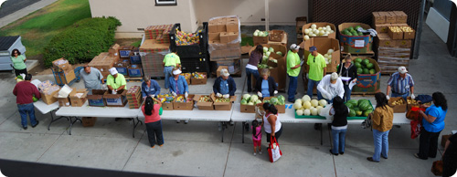
Second Harvest Food Bank:
Director of Project Management
What does food distribution look like on the ground at warehouses and partner agencies?
Stories about times you’ve interacted with local distributors?
Walk me through how online inventory of produce works?
How much of the food you distribute comes from families and why?
How do people find out about the food bank?
How do you motivate individuals to donate in food drives?

Slide 20
SAY
THINK
I think that Kate is motivated by the idea of putting her skills to use to help people in her community.
I think Kate appreciates the value of community and partnership on many levels (motivating people to donate, the distribution chain).
“Everyone can have an open heart about feeding the hungry.”
“We don't want to put [items with a shorter shelf life] online because that adds 2 days to the process.”
“We don’t do prepared food - there are food safety concerns and it’s not an efficient use of resources.”
“Financial donations are what we prefer, frankly.”
“There is often a disconnect between what people want to give and what our clients need.”
“The kinds of people we tend to work with have issues with trust.”
DO
FEEL
Spoke with a passionate tone when discussing the disconnect between individual motivations and client needs.
Invited her innovation colleage who’s trying to disrupt food distribution onto the call.
Described each process in thorough detail
I think Kate feels frustrated when donors aren’t able to understand end clients’ nutritional needs.
I think Kate feels passionate about closing the existing need gap in the SC and SM counties.
Kate feels empathetic to the hardships of food transporters without proper vehicles.
She feels the need for practical solutions that sometimes counter intuition (no prepared food).

Slide 21

Second Harvest Food Bank:
VP of Operations
What types of people do you interact with and oversee?
Tell me about the Food Connection team and what their conversations with clients look like?
Why are people wary of food stamps?
How do you measure success in your work?
Current major operational initiatives?
What are you and your coworkers’ shared motivations?
How does the food bank make money?
How do you motivate personal donations?

Slide 22
SAY
THINK
I think that Bruno is motivated by the 300-400K large population that is still food insecure.
I think he understand the value of having people who have experienced hunger firsthand involved in the process, as colleagues or donors.
“We need to have a true client database that is shared among the various agencies involved in the food distribution.”
“One of the board members has gone through hunger insecurity as a child.”
“Often people wait for the last minute to ask for help. There is a lot of stigma, especially in teenagers.”
“We are 94% funded through donations.”
DO
Feels a sense of community with coworkers about helping their local community.
Passionate about tackling the biggest problems first - getting people information and awareness.
Emphasizes with specific needs of clients - age, mobility issues, work schedules.
FEEL
Used words like “fortunate” to describe the strong brand image of the Second Harvest Food Bank in the counties it serves
Did not bring up his personal history in the tech industry until explicitly asked.
Drew on personal anecdotes about stories that worked for him.

Slide 23
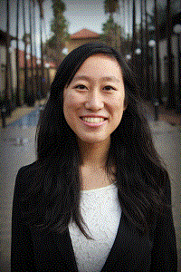
Stanford SPOON
Can you walk me through the process of contacting food waste creators on campus, collecting, and delivering food?
Stories about when you have interacted with end clients?
What are some of your best memories with SPOON?
What are some times that you’ve run into issues with the delivery process?
History and success of the organization over the years?
Discuss any bureacratic difficulties along the pipeline?
“It was fun and totally normal. Most of them are pretty friendly. While serving food, I got to know the people I was working with better. It was interesting to see these people – there are people just like us – and I had a good time.”

Slide 24
Outline
Introduction to Us
Our Focus Area
Needfinding Methodology
Interview Results
Initial Analysis

Slide 25
Initial Analysis: Needs
-incentives for stores to donate
-resources that make reducing waste easier for businesses
-faster delivery methods of food (overcoming traffic) -education for acceptable food to donate
-methods for the general public (not businesses) to donate leftovers
-methods for measuring how much food is thrown away
-nuanced focus on seniors, working parents, people with mobility issues, & those who live in alternate housing
-inform the 600,000-700,000 food insecure people in SM and SC counties of resources

Slide 26
Initial Analysis: Insights and Questions
Insights:
-many wished they could do something about waste, but waste seems inevitable
-emotions: shame, guilt
-leverage locavore mentality: food is perishable and shouldn’t be have to be driven across the bay
Questions:
-Which part of the pipeline do we want to be involved in?
-Who are our end users?
-Given our understanding of current innovation, how can we contribute?
-What types of foods are wasted the most? Understanding the stats better
-How might we empower local communities to learn about, care, and act upon the issue of hunger insecurity?

Slide 27
Summary

Slide 28
